Slide 1


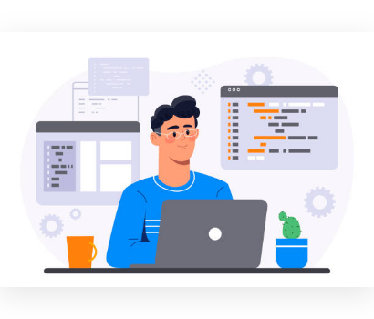

Site Security Implementation
Issues, Resolutions, and Lessons Learned
An engineering account of building and verifying the Site Security feature inside an existing team codebase.
Wendtoin Filomène Tania ZABRE
feature/sitesecurity/init
Implementation is not only about writing code — it is about managing versions, databases, containers, and verification.

Slide 2


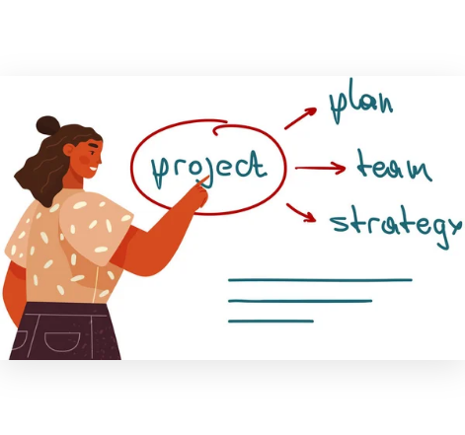



Project Context & Scope
Inherited Repository Architecture
Inherited a team codebase with an approved frontend mockup. The mandate was to implement seamlessly inside existing structures without redesigning baseline architecture.
Implementation Scope (6 Core Areas)
Database Persistence
Backend Service
REST API Endpoints
Frontend Integration
Frontend Interface
Runtime Docker Stack
KEY DELIVERABLES
10 Commits Builds Passing API 200 OK
Site Security Implementation · Project Context
BIT Excellence Program

Slide 3



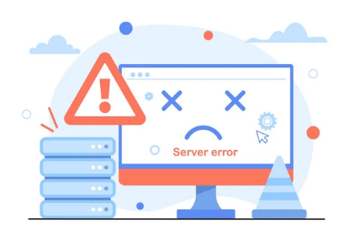


Environment & Build Challenges
Engineering Mindset Shift: Resisted early temptation to audit/redesign "missing" repo structures. Shifted focus immediately to building inside the agreed team configuration.
Issue: Java 21 required; local machine ran Java 8.
Issue: Mismatch between docs (4.1.0) and POM (3.4.3).
Fix: Executed build inside Docker container; runtime logs verified JDK 21.0.12.
Fix: Restored Spring Boot 4.1.0 in pom.xml; verified full build pass.
Issue: Docker Desktop daemon was inactive locally.
Issue: Compose showed no active running services.
Fix: Started Docker daemon and validated background container engine readiness.
Fix: Initialized existing Compose environment; brought DB & backend online.
Site Security Implementation · Environment & Build Resolution
BIT Excellence Program

Slide 4



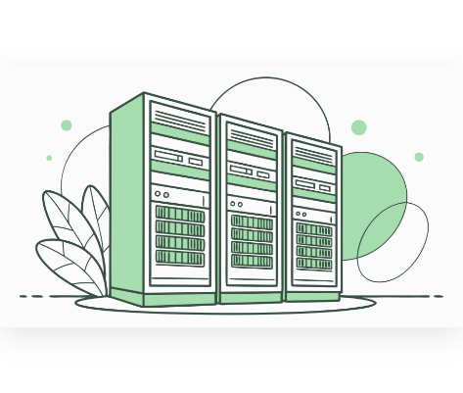




Database & Persistence Engineering
H2 Runtime Failure → PostgreSQL Pivot
Early backend execution failed with H2 missing the SITE_SECURITY_LOGS table (runtime schema initialization error, not compile time).
Resolution: Purged unused H2 dependency and configured target PostgreSQL. Hibernate auto-created schema, establishing full database persistence.
Read-Only Seed Audit Verification
4
4
5
6
9
Gates
Zones
Users
Logs
Reqs
Committed persistence logic & seeds — never database volumes, raw rows, or credentials.
Site Security Implementation · Database Persistence
BIT Excellence Program

Slide 5

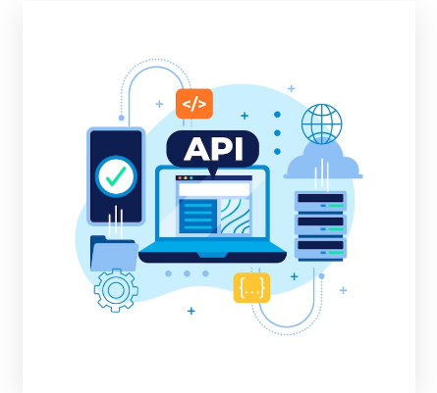


Frontend–Backend Integration & Build
Replaced initial visual mock behaviors with real API boundaries. Connected feature hooks, handling async state, response mapping, filtering, and zone selections.
REST ENDPOINT PATH HTTP STATUS
GET /api/v1/sitesecurity/overview
GET /api/v1/sitesecurity/zones
GET /api/v1/sitesecurity/credentials
GET /api/v1/sitesecurity/logs
FRONTEND PRODUCTION BUILD
2,218
Vite Production Bundle Passed
modules transformed
Site Security Implementation · API Integration & Build
BIT Excellence Program

Slide 6


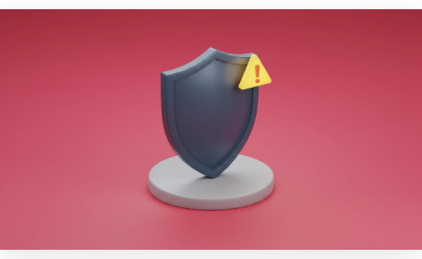


Security, Git Discipline & Verification
10 Focused, Granular Commits
Structured work across database persistence, seed logic, REST controller, frontend shells, API boundary, hooks, and UI components.
Single staging area caused repeated conflicts — resolved by selective unstaging and re-verification.
Secrets Guarded: Zero .env keys, DB dumps, credentials, target/ or node_modules/ committed.
Transparent Engineering Limitations
•
jq unavailable: Substituted with custom Node.js script for JSON response validation.
•
No browser automation: Executed HTTP & bundle integrity checks in lieu of Selenium/Playwright.
•
Container gap: Running container predated final commits — flagged gap rather than hiding runtime state.
FINAL VERIFICATION PASS
Site Security Implementation · Git & Security Discipline
BIT Excellence Program

Slide 7







"I didn't just write the feature — I made it buildable, testable, reviewable, and safe to deliver."
4 Core Lessons Learned
1. Implementation Scope
2. Micro Checkpoints
Broader than coding — includes versions, databases & containers.
Frequent small verifications prevent cascading integration bugs.
3. Honest Testing
4. Runtime vs Source
A passed test ≠ unperformed test; state boundaries clearly.
Docker container runtime state differs from static git source code.
Immediate Next Steps / Roadmap
•
Rebuild Docker images & recreate containers preserving PostgreSQL volumes.
•
Perform end-to-end manual browser testing (navigation, filtering, zone selection).
•
Externalize hardcoded datasource credentials into environment variables.
Wendtoin Filomène Tania ZABRE
BIT Excellence Program · Farm Security Module

Slide 8






Image Sources
https://media.istockphoto.com/id/1413922045/vector/programming-at-home.jpg?s=612x612&w=0&k=20&c=_5UhZu0-etj-lWZorNUAkF_PEqXfHpuf44dCeWeCOvc=
Source: www.istockphoto.com
https://st.depositphotos.com/2419757/57545/v/450/depositphotos_575458808-stock-illustration-manager-reports-project-team-work.jpg
Source: depositphotos.com
https://st5.depositphotos.com/26922084/66942/v/450/depositphotos_669429786-stock-illustration-server-error-concept-technical-problems.jpg
Source: depositphotos.com
https://www.21medien.de/assets/img/illustrations/gpu-server-cluster-2.webp
Source: www.21medien.de
https://img.magnific.com/free-vector/flat-design-api-illustration_23-2149392284.jpg?semt=ais_hybrid&w=740&q=80
Source: www.magnific.com
https://dolfd84j73uh7.cloudfront.net/images/2d0918ad948326b2.webp
Source: www.develeap.com

Slide 9

Image Sources
https://media.istockphoto.com/id/2199654193/vector/woman-climbing-books-towards-success-in-education-and-career-flat-vector-illustration.jpg?s=612x612&w=0&k=20&c=0KjsmMGf-hBkezYRrgHmssYcDudNP3PEGsTXyc_hMTA=
Source: www.istockphoto.com

